Slide 1
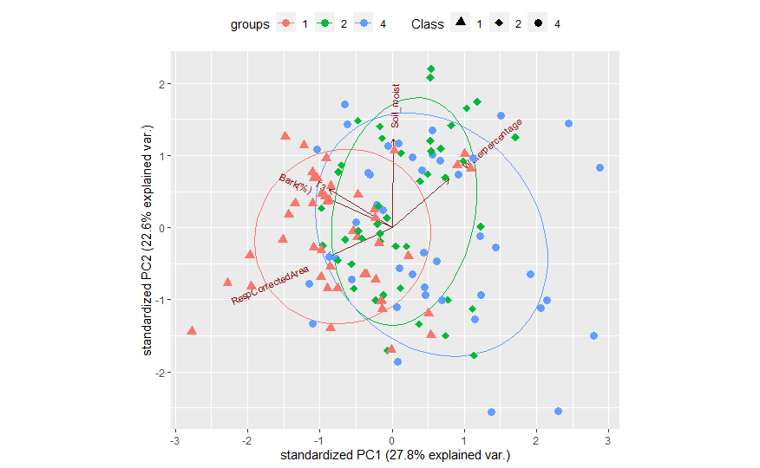
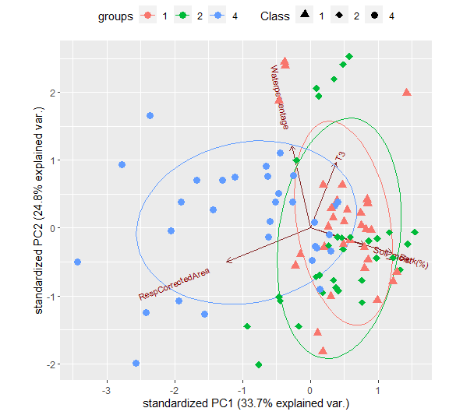
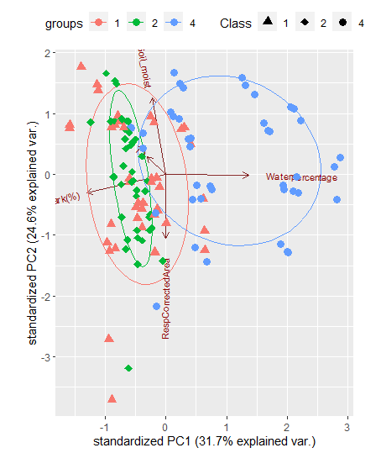
Abies alba
1 cm
10 cm
25 cm
Principal Componen análisis of Abies Alba comparing waterpercentage, Temperature (T3),Bark and Soil_moisture of the three diameters studied (1,10,25). Colours of the dots and ellipses correspond to samples of the three different degradation classes (1,2,4).

Slide 2
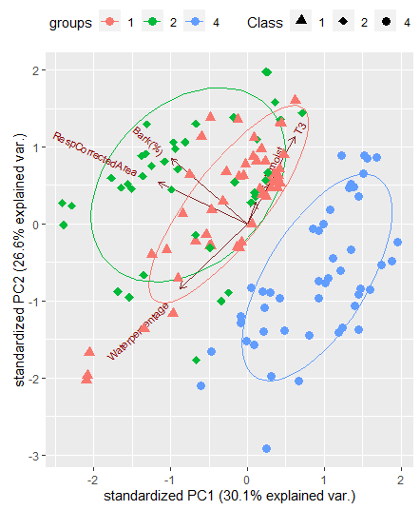
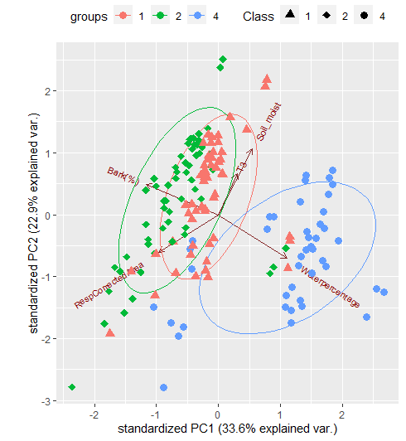
Fagus sylvatica
1 cm
10 cm
25 cm
Principal Componen análisis of Fagus sylvatica comparing waterpercentage, Temperature (T3),Bark and Soil_moisture of the three diameters studied (1,10,25). Colours of the dots and ellipses correspond to samples of the three different degradation classes (1,2,4).

Slide 3
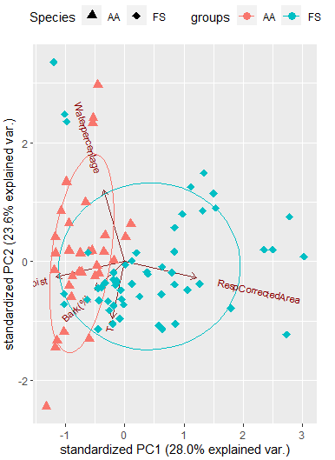
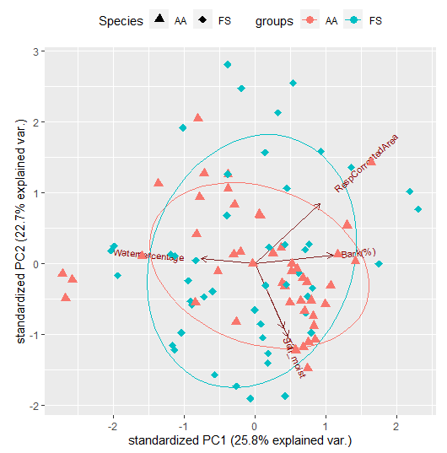
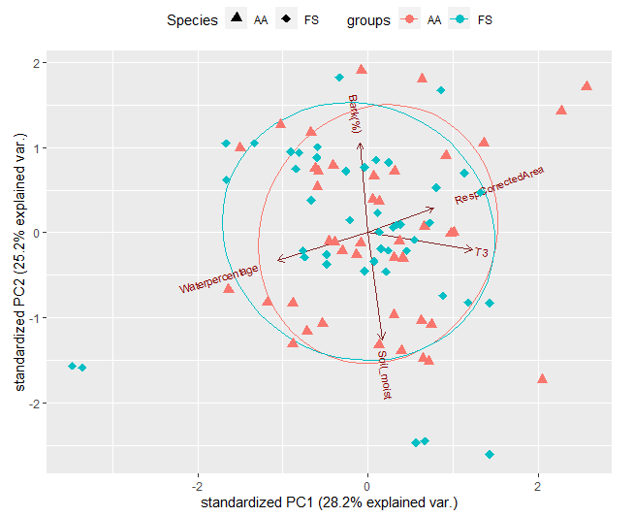
Class 1
1 cm
10 cm
25 cm
Principal Componen análisis of Fagus sylvatica and Abies alba class 1, comparing waterpercentage, Temperature (T3),Bark and Soil_moisture of the three diameters studied (1,10,25). Colours of the dots and ellipses correspond to both of the species.

Slide 4
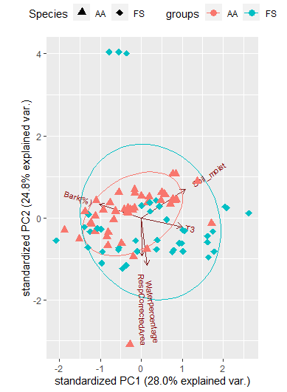
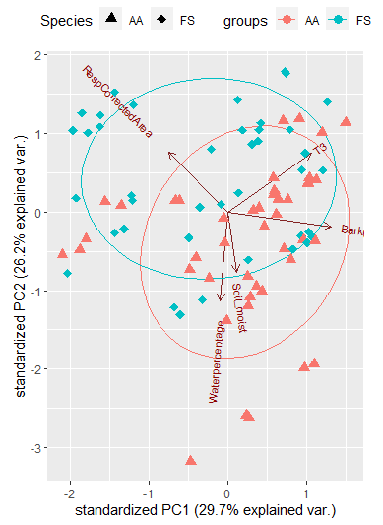
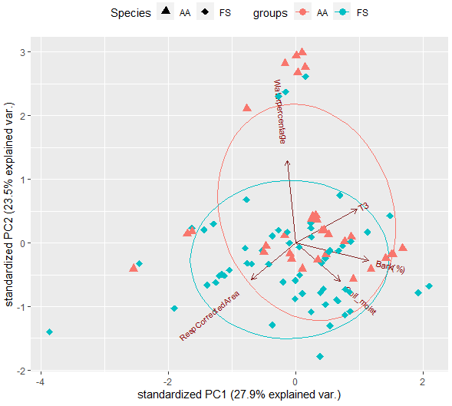
Class 2
1 cm
10 cm
Principal Componen análisis of Fagus sylvatica and Abies alba class 2, comparing waterpercentage, Temperature (T3),Bark and Soil_moisture of the three diameters studied (1,10,25). Colours of the dots and ellipses correspond to both of the species.
25 cm

Slide 5
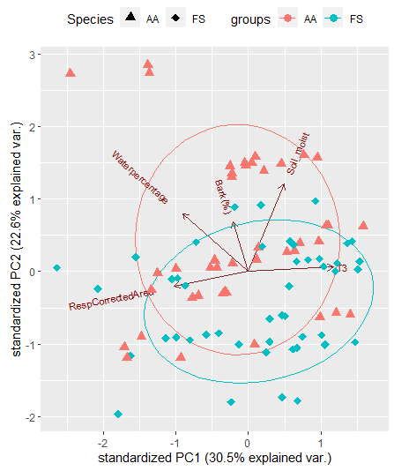
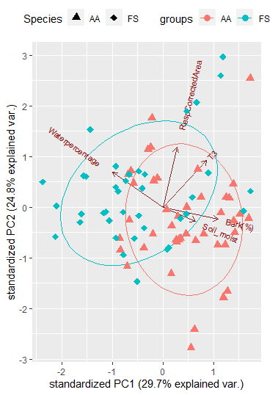
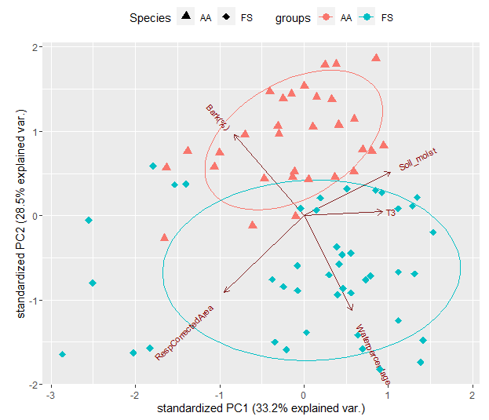
Class 4
1 cm
10 cm
Principal Componen análisis of Fagus sylvatica and Abies alba class 4, comparing waterpercentage, Temperature (T3),Bark and Soil_moisture of the three diameters studied (1,10,25). Colours of the dots and ellipses correspond to both of the species.
25 cm

Slide 6

Respiration µM CO₂/s * cm²
d
a
a
b
bc
c
c
a
a
a
a
d
b
c
c
a
a

Slide 7
a
a
b
b
c
a
ab
ab
b
d
c
d
ab
b
a
d
e
Quantity of bark (%) of Abies alba (Blue) and Fagus sylvatica (Orange) in
three degradation classes (1, 2 and 4). Supperscripted letters denote statistically
significant differences at p < 0.05 after Wilcoxon signed-rank test.

Slide 8
b
bc
Water (%)
c
bc
a
b
bc
d
a
b
a
d
c
b
b
a
a
a
c
Water content (%)of Abies alba (Blue) and Fagus sylvatica (Orange) in
three degradation classes (1, 2 and 4). Supperscripted letters denote statistically
significant differences at p < 0.05 after Wilcoxon signed-rank test.

Slide 9
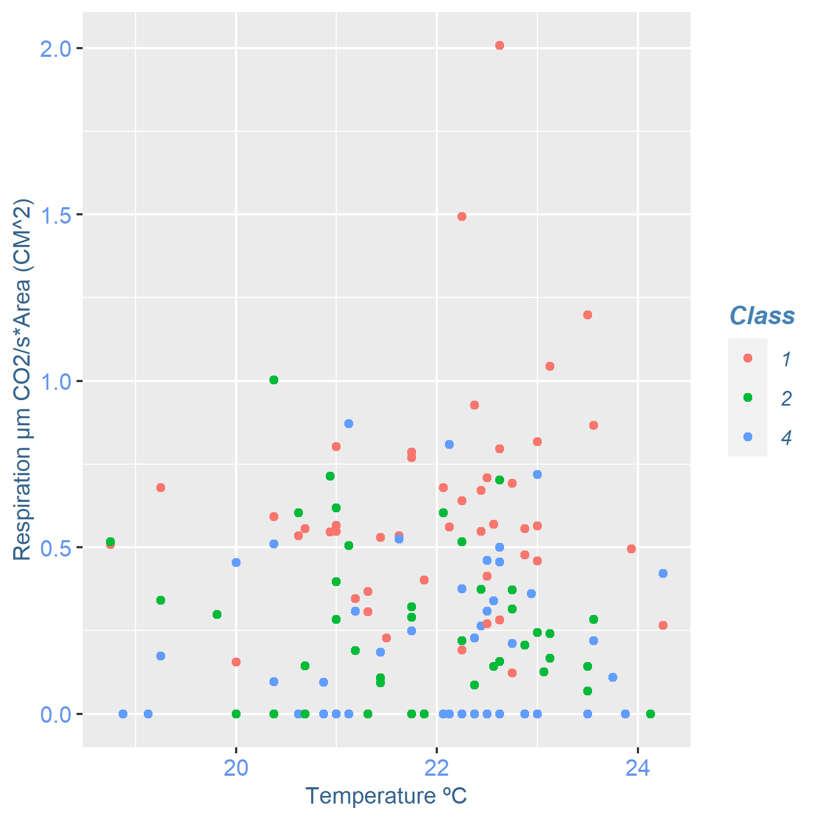
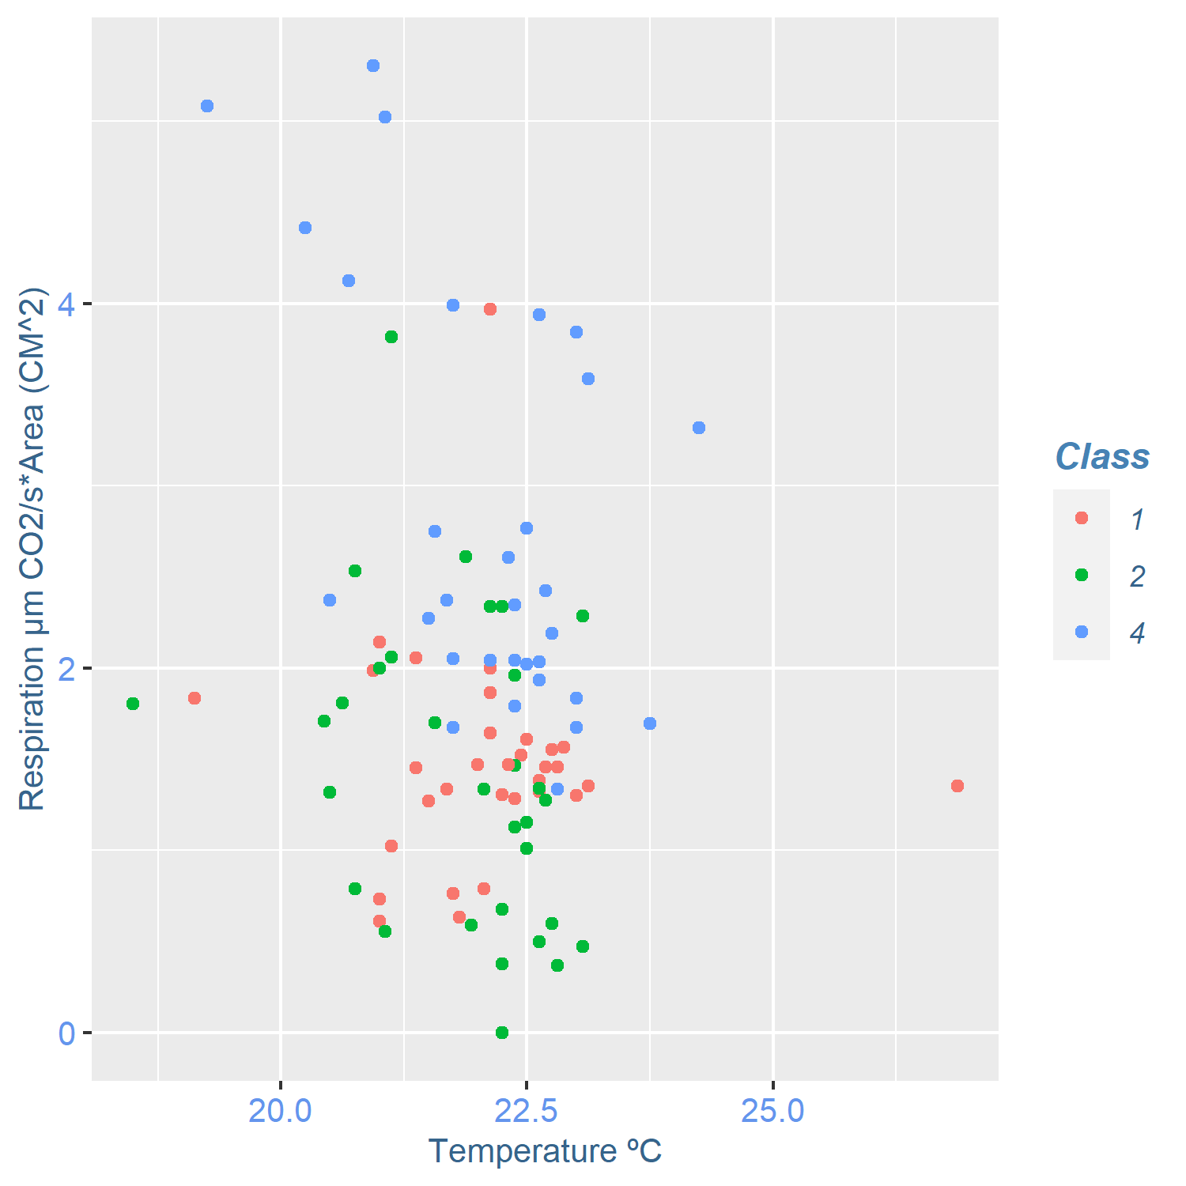
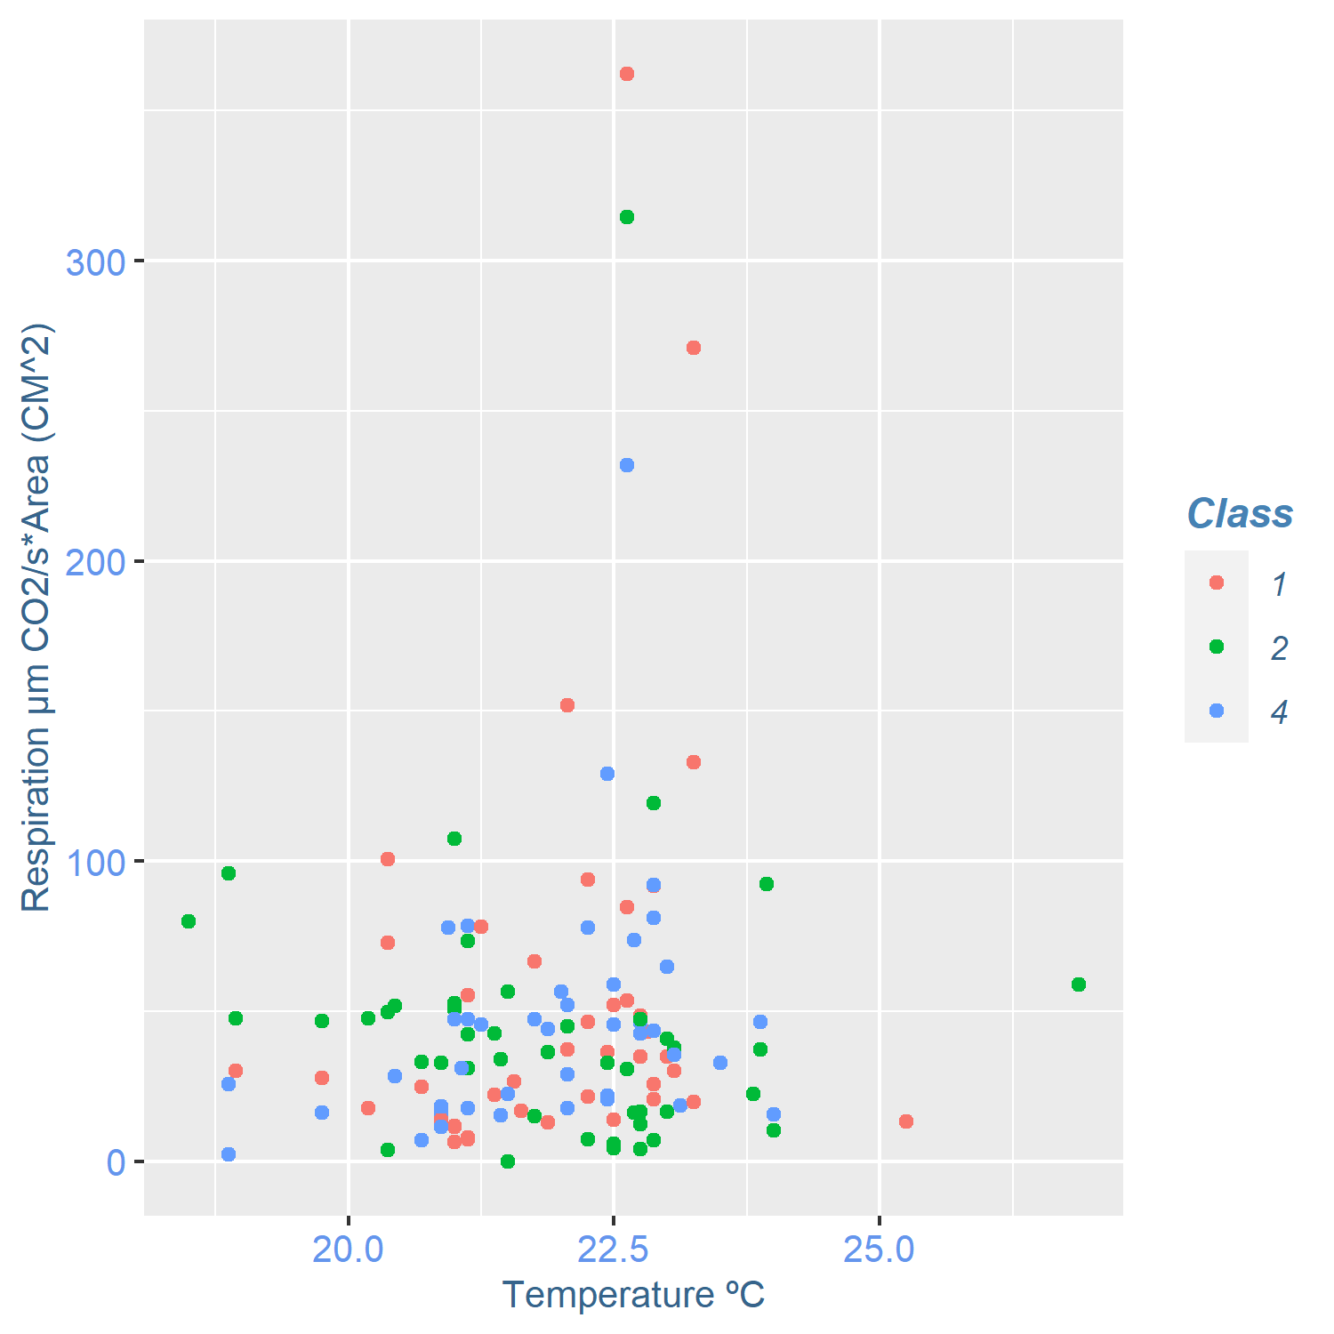
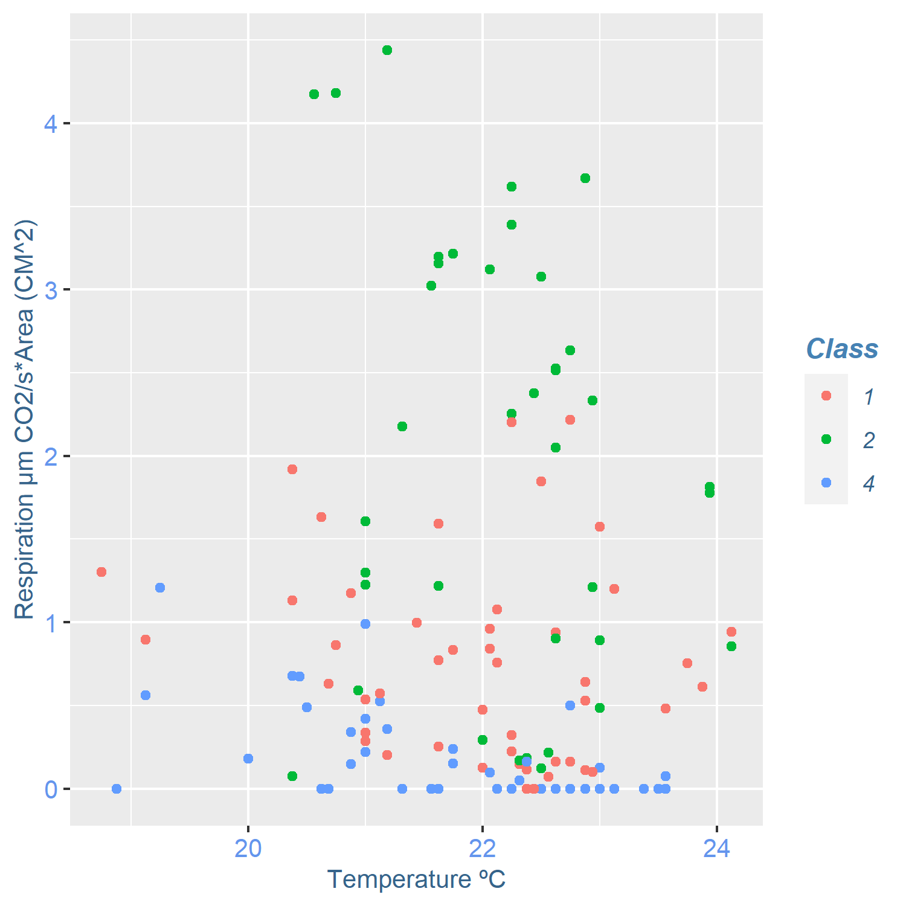
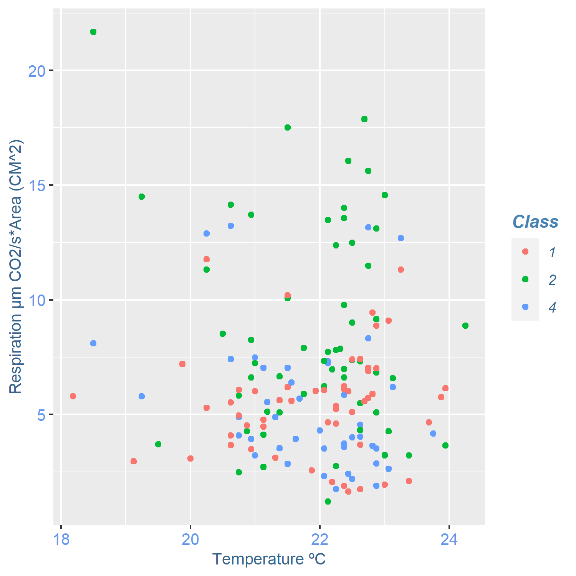
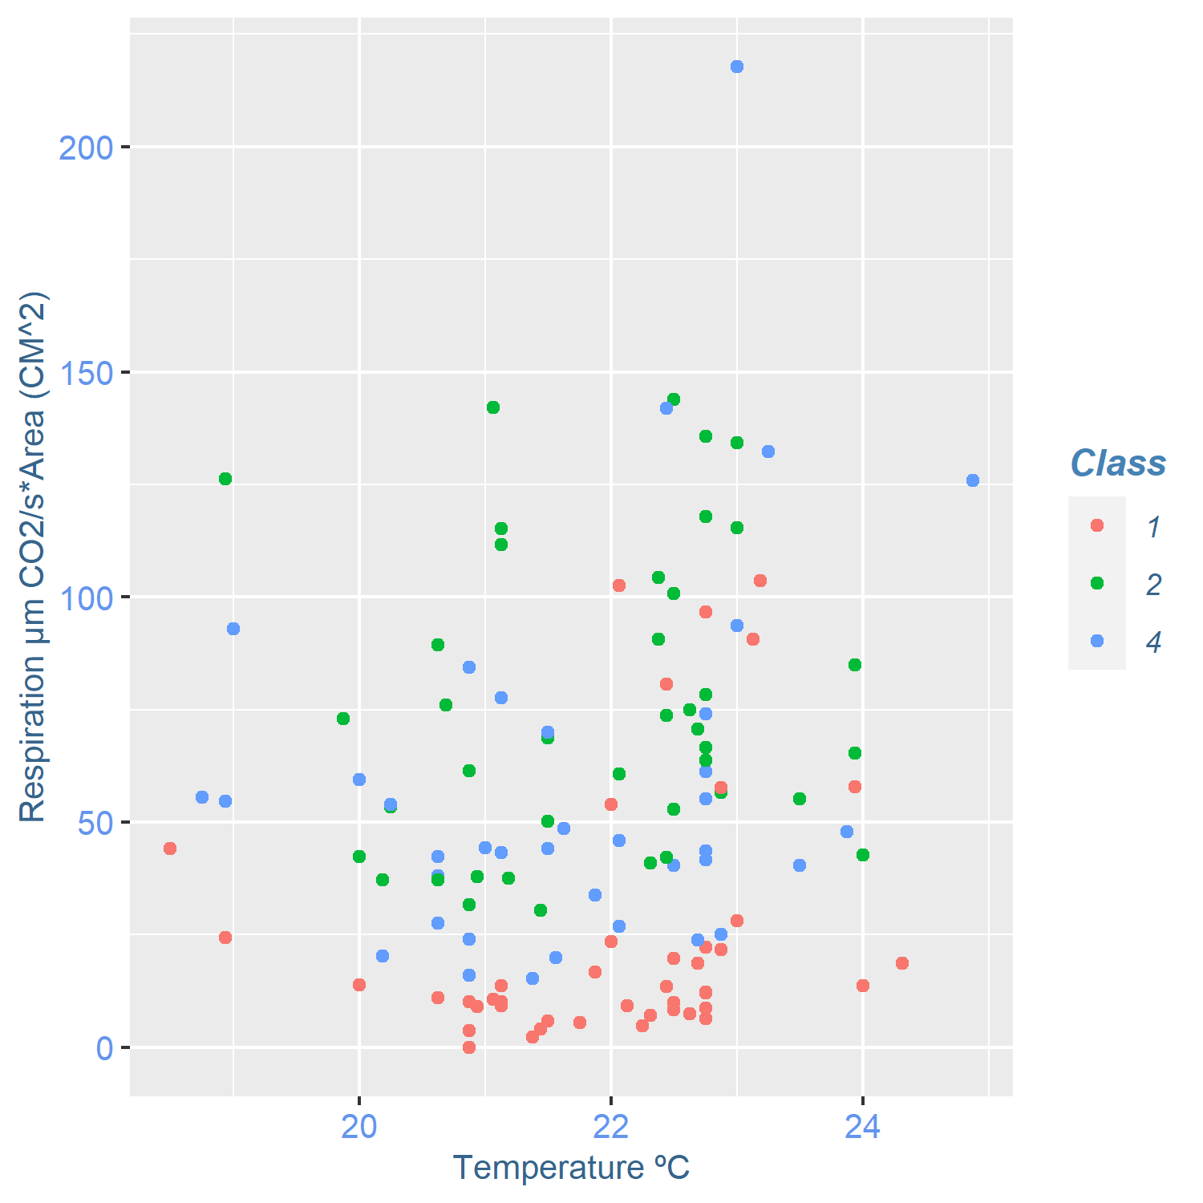
1 cm
10 cm
25 cm
Abies alba
Scatterplot of the respiration in µM CO₂/s * cm² (Y-axis) and Temperature (ºC) (X-axis) of Abies alba (up) and Fagus sylvatica (down). Colour of the dots correspond to degradation classes 1(red), 2(green) and 4(blue)
Fagus sylvatica

Slide 10
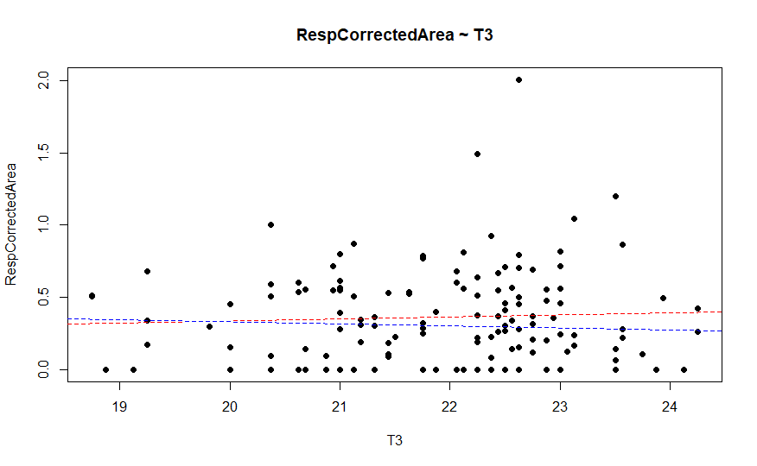
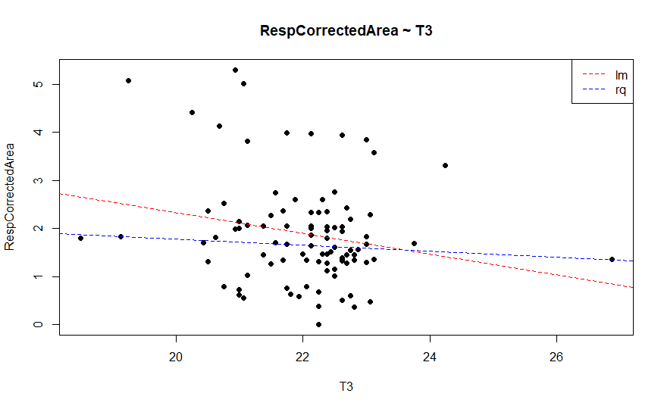
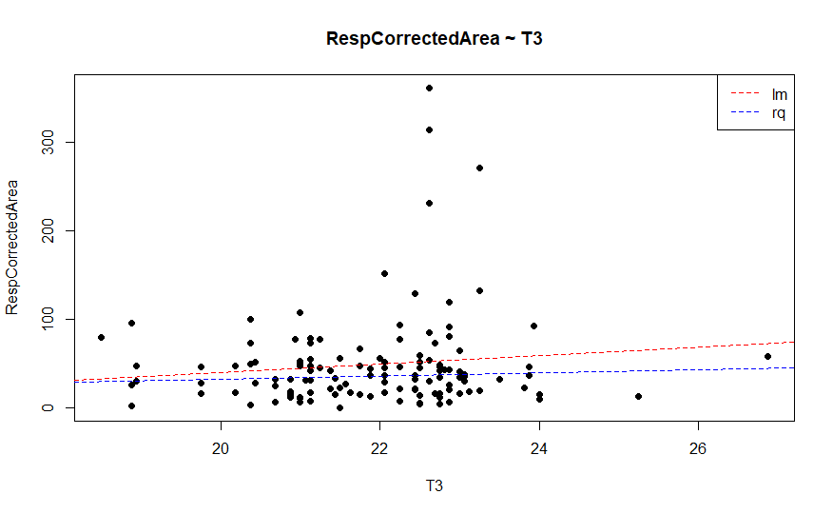
A
B
Scatterplot of the respiration in µM CO₂/s * cm² (Y-axis) and Temperature (ºC) (X-axis) of Abies alba 1 cm(A), 10 cm(B) and 25 cm(C) diameters. Lines correspond to linear (red) and quantile (blue) regresión.
.
Abies alba
C

Slide 11
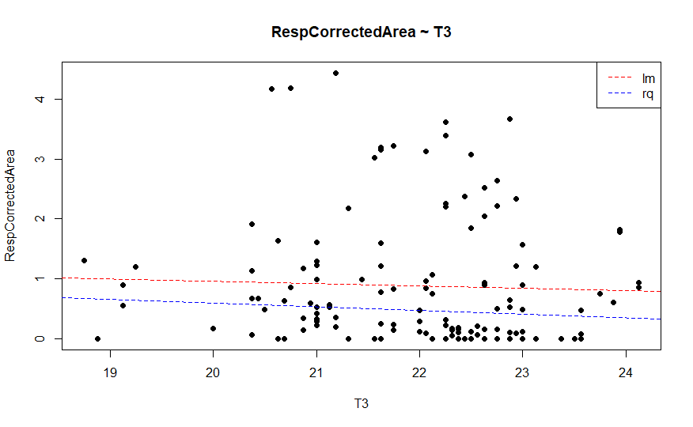
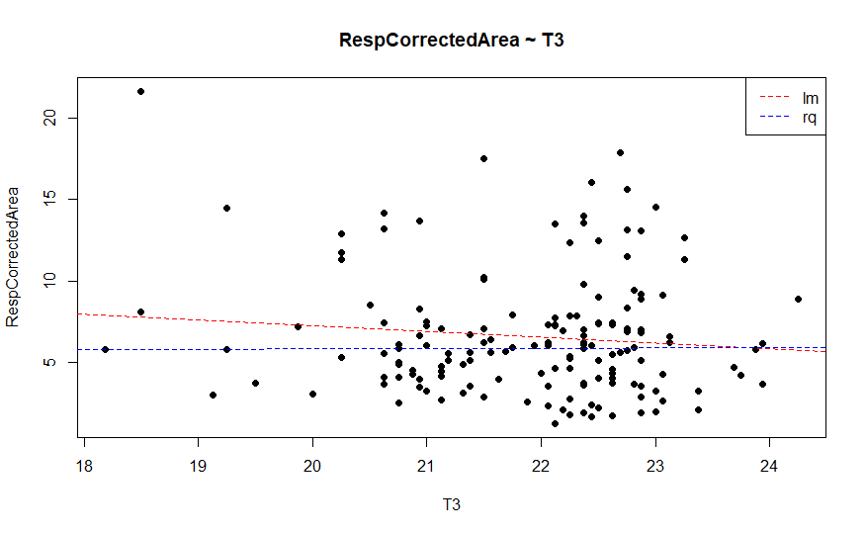
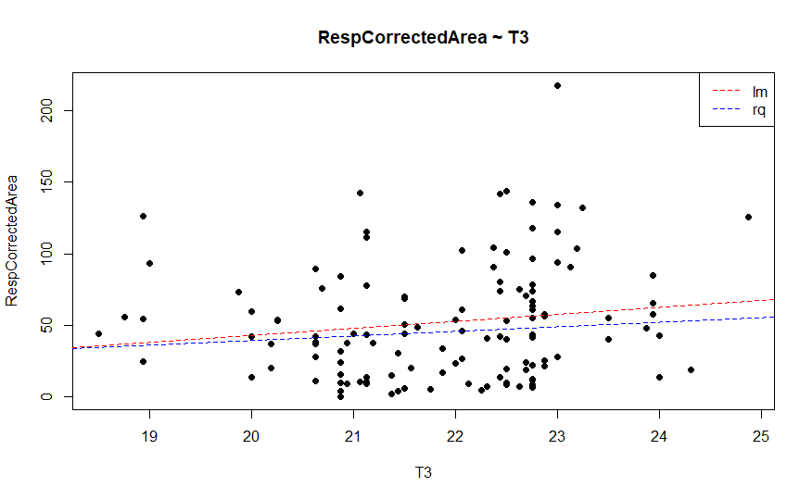
A
B
Scatterplot of the respiration in µM CO₂/s * cm² (Y-axis) and Temperature (ºC) (X-axis) of Fagus sylvatica 1 cm(A), 10 cm(B) and 25 cm(C) diameters. Lines correspond to linear (red) and quantile (blue) regresión.
.
C
Fagus sylvatica

Slide 12
Spearman correlations for Respiration corrected by Area and air temperature
Group | p - value
Abies alba 1 cm | 0.8231
Abies alba 10 cm | 0.05946
Abies alba 25 cm | 0.4133
Fagus sylvatica 1 cm | 0.1769
Fagus sylvatica 10 cm | 0.6249
Fagus sylvatica 25 cm* | 0.03713 , rho = 0.1881
Spearman correlation comparing the respiration in µM CO₂/s * cm² and Temperature (ºC) of Abies alba and Fagus sylvatica of each of the diameters studied. * denote statistically significant correlation at p<0.05. Rho value is displayed in those values with significant correlation.

Slide 13
Spearman correlations for Respiration corrected by Area and air temperatura separated by Species, class and diameter
 | Abies Alba
 | 1cm | 10cm | 25cm
Class
1 | 0.2499 | 0.9602 | 0.08466
2 | 0.1623 | 0.02089* rho = -0.400 | 0.07411
4 | 0.4506 | 0.0096* rho=-0.457 | 0.0337 rho=0.32
Those with statistically significant correlation are represented below
 | Fagus sylvatica
Class | 1cm | 10cm | 25cm
1 | 0.09596 | 9.2389 | 0.01137 Rho = 0.37
2 | 0.8314 | 0.698 | 0.1453
4 | 0.00007762 Rho = -0.542 | 0.04196 Rho = -0.311 | 0.2306
Spearman correlation comparing the respiration in µM CO₂/s * cm² and Temperature (ºC) of Abies alba and Fagus sylvatica of each of the diameters studied and class studied. * denote statistically significant correlation at p<0.05. Rho value is displayed in those values with significant correlation.

Slide 14
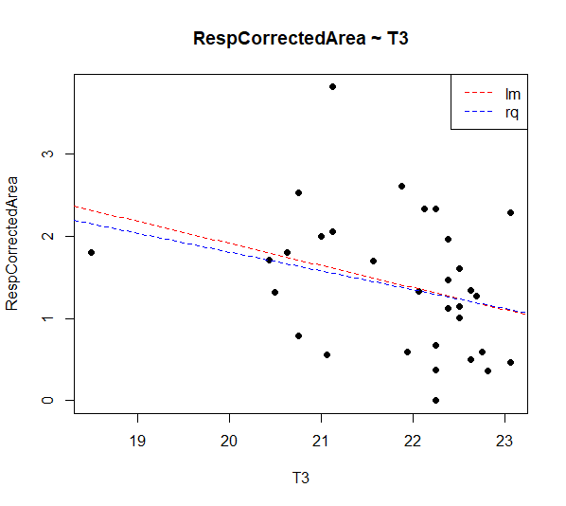
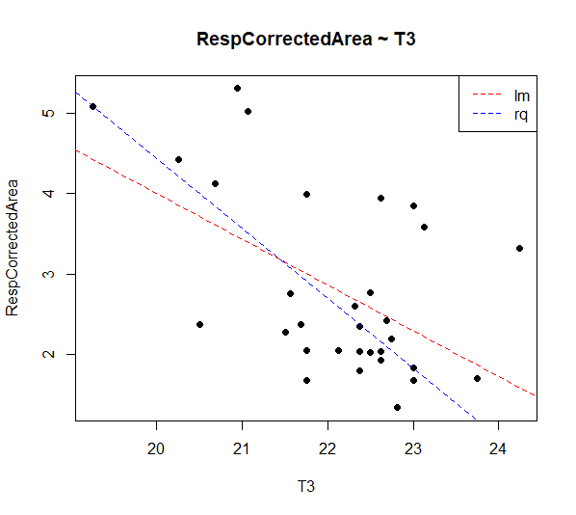
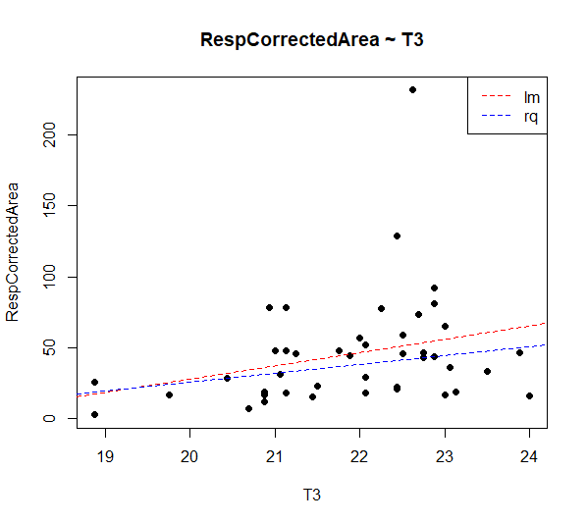
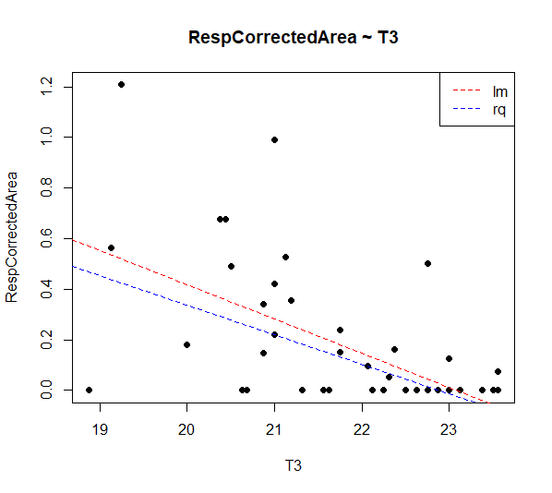
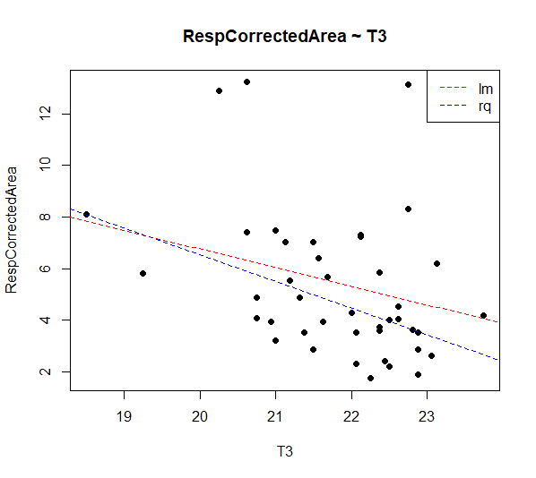
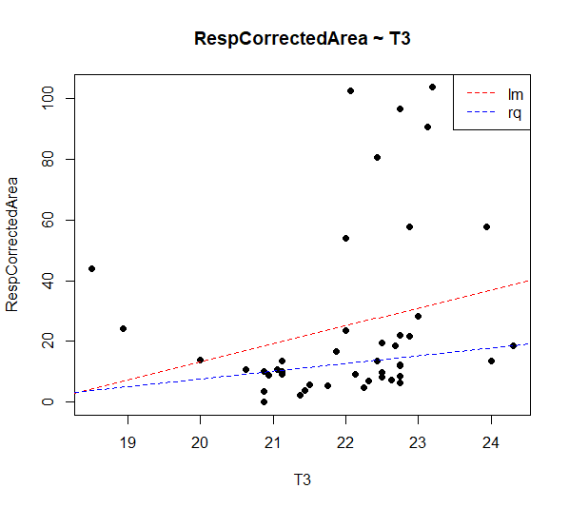
Respiration (µM CO₂/s * cm²⁾
Temperature (ºC)
Temperature (ºC)
Temperature (ºC)
Abies alba 10 cm. Class 2
Abies alba 10 cm. Class 4
Abies alba 25 cm. Class 4
Respiration (µM CO₂/s * cm²⁾
Temperature (ºC)
Temperature (ºC)
Temperature (ºC)
Fagus sylvatica 1 cm. Class 4
Fagus sylvatica 10 cm. Class 4
Fagus sylvatica 25 cm. Class 4

Slide 15
Scatterplot of the respiration in µM CO₂/s * cm² (Y-axis) and Temperature (ºC) (X-axis) of those groups who resulted in a statistically significicant correlation . Lines correspond to linear (red) and quantile (blue) regresión.

Slide 16
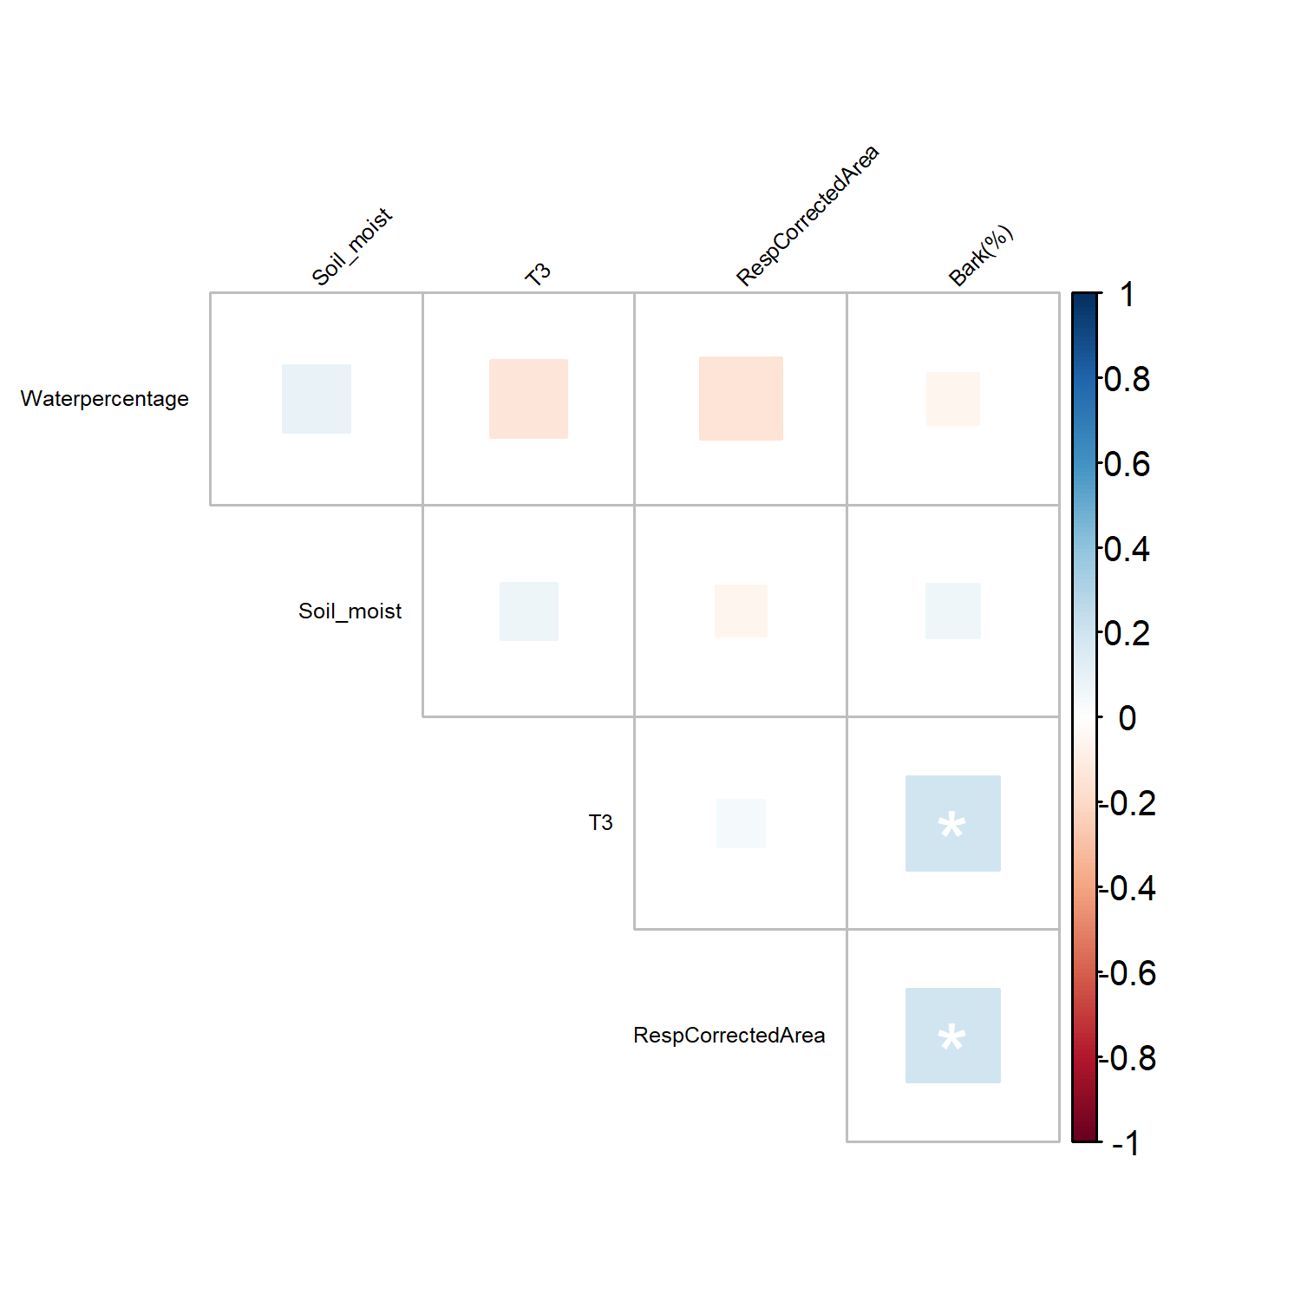
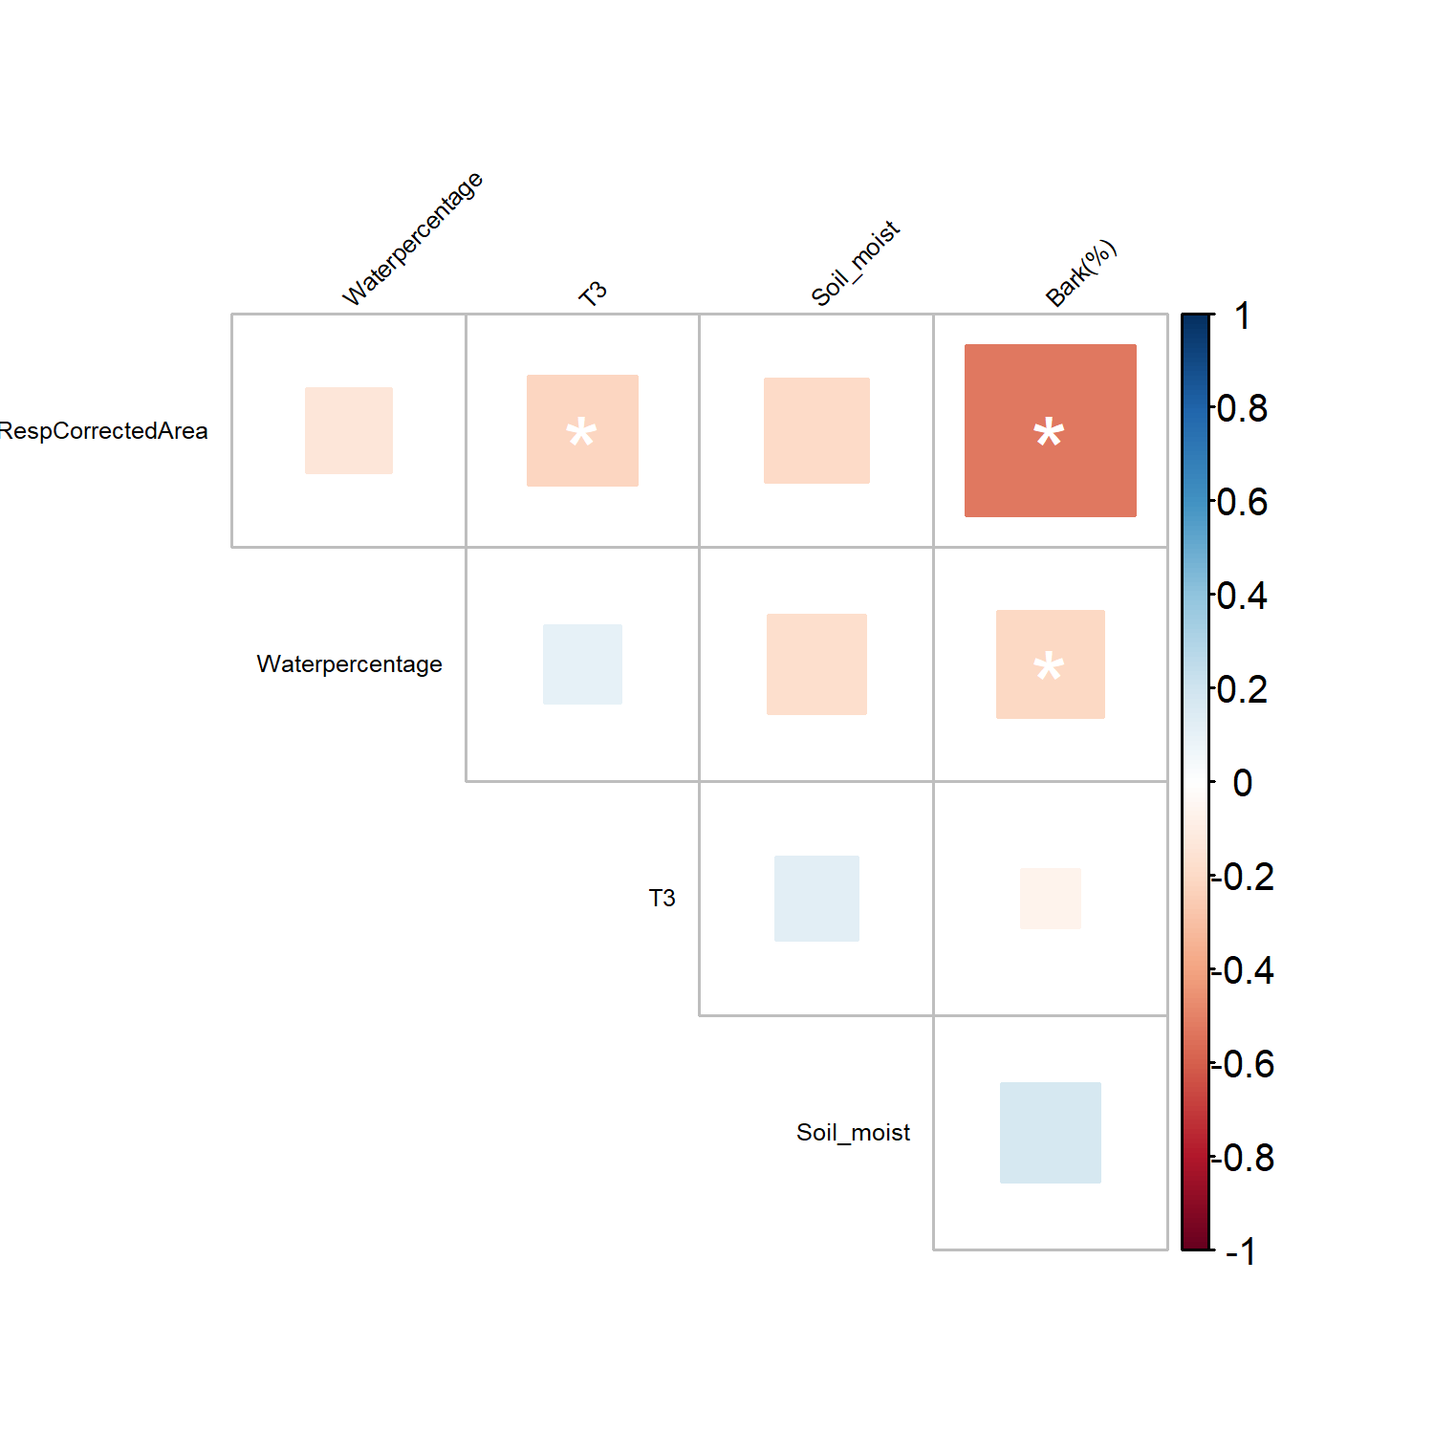
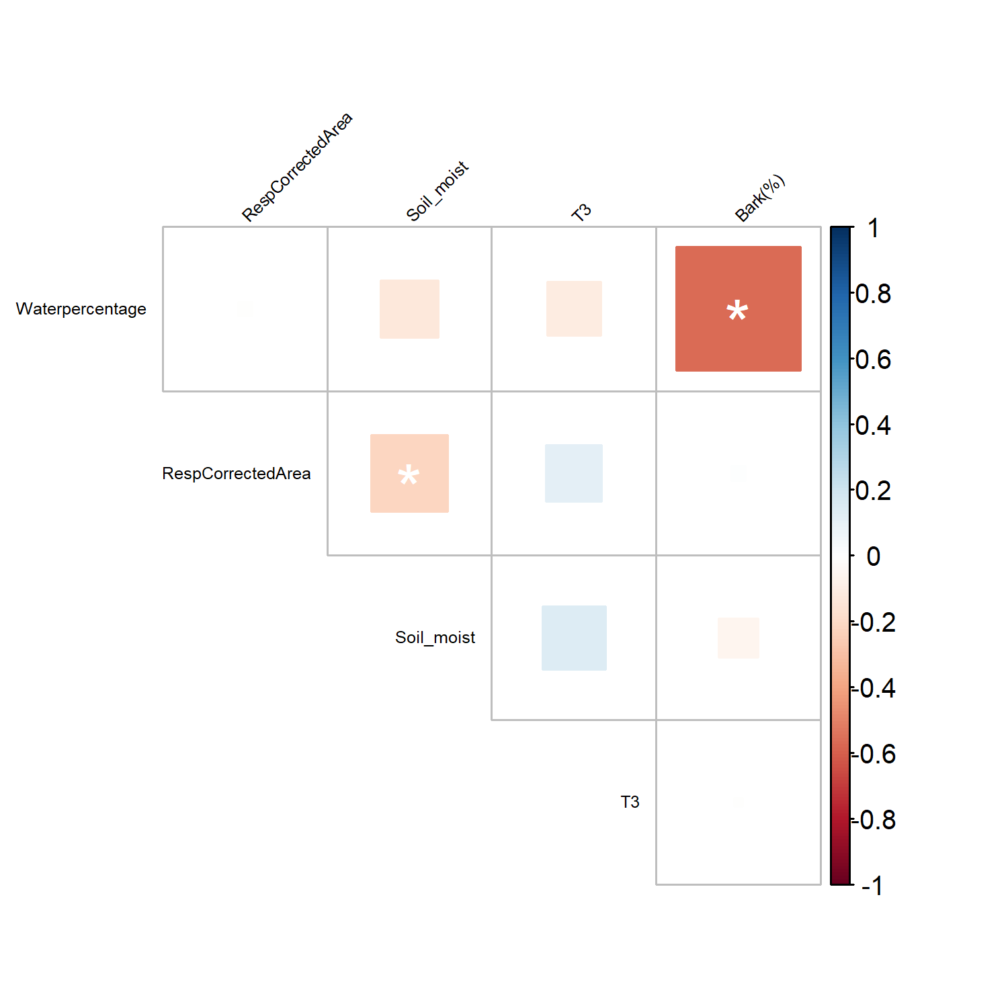
Abies alba
Pearson Correlation
1 cm
10 cm
25 cm
Pearson correlation of three diameter classes (1, 10 and 25 cm) of Abies alba. * denote statistically significant correlation at p < 0.05

Slide 17
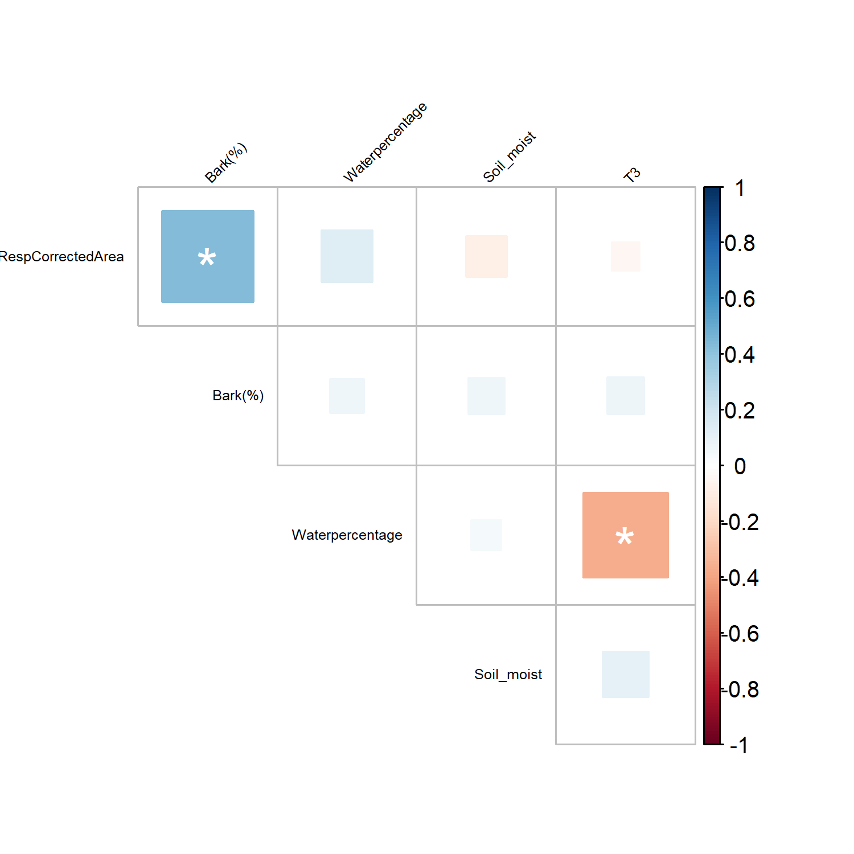
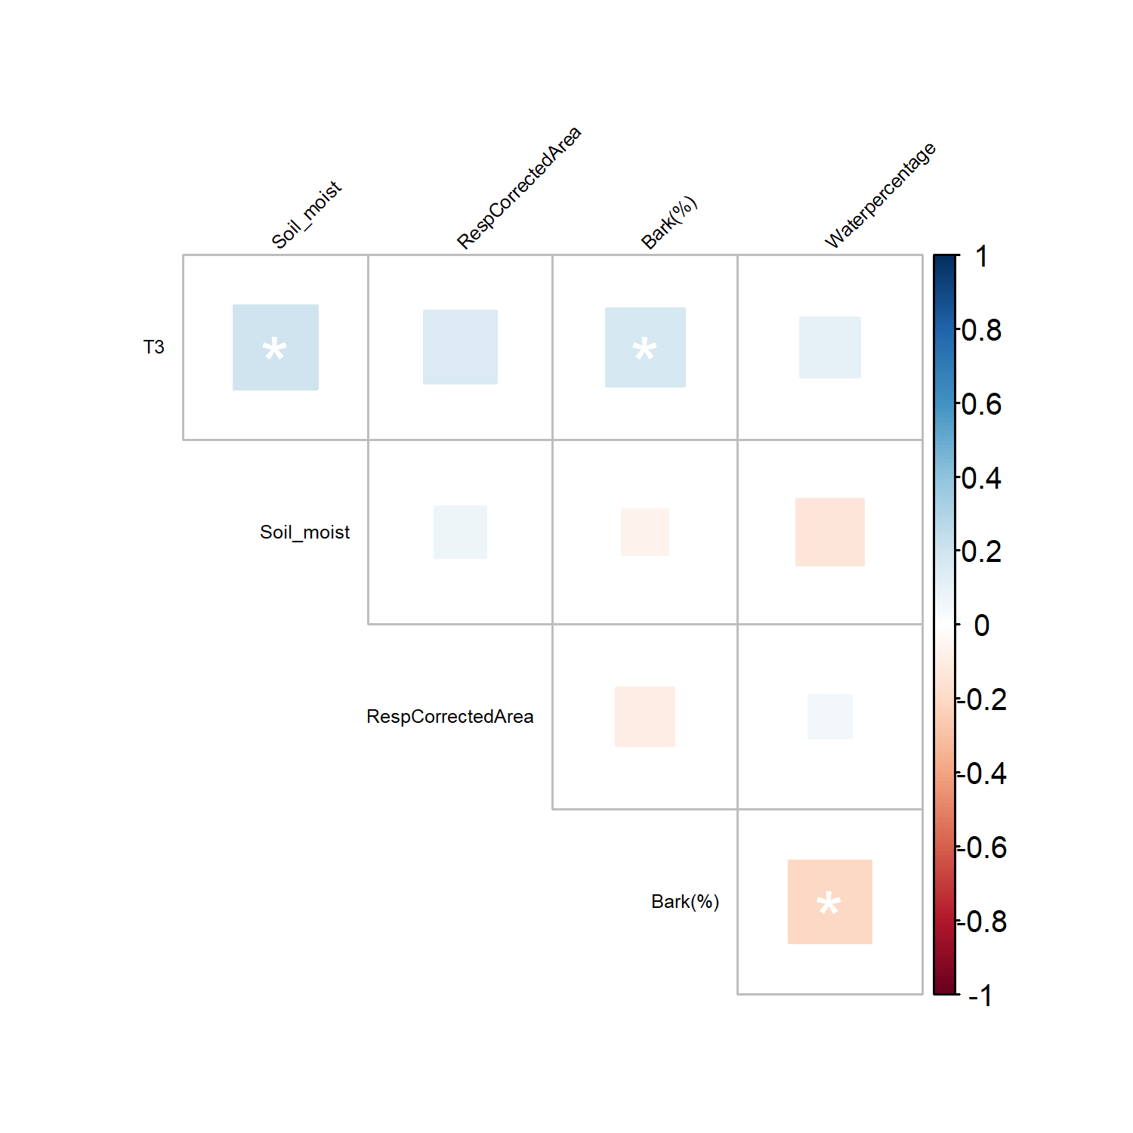
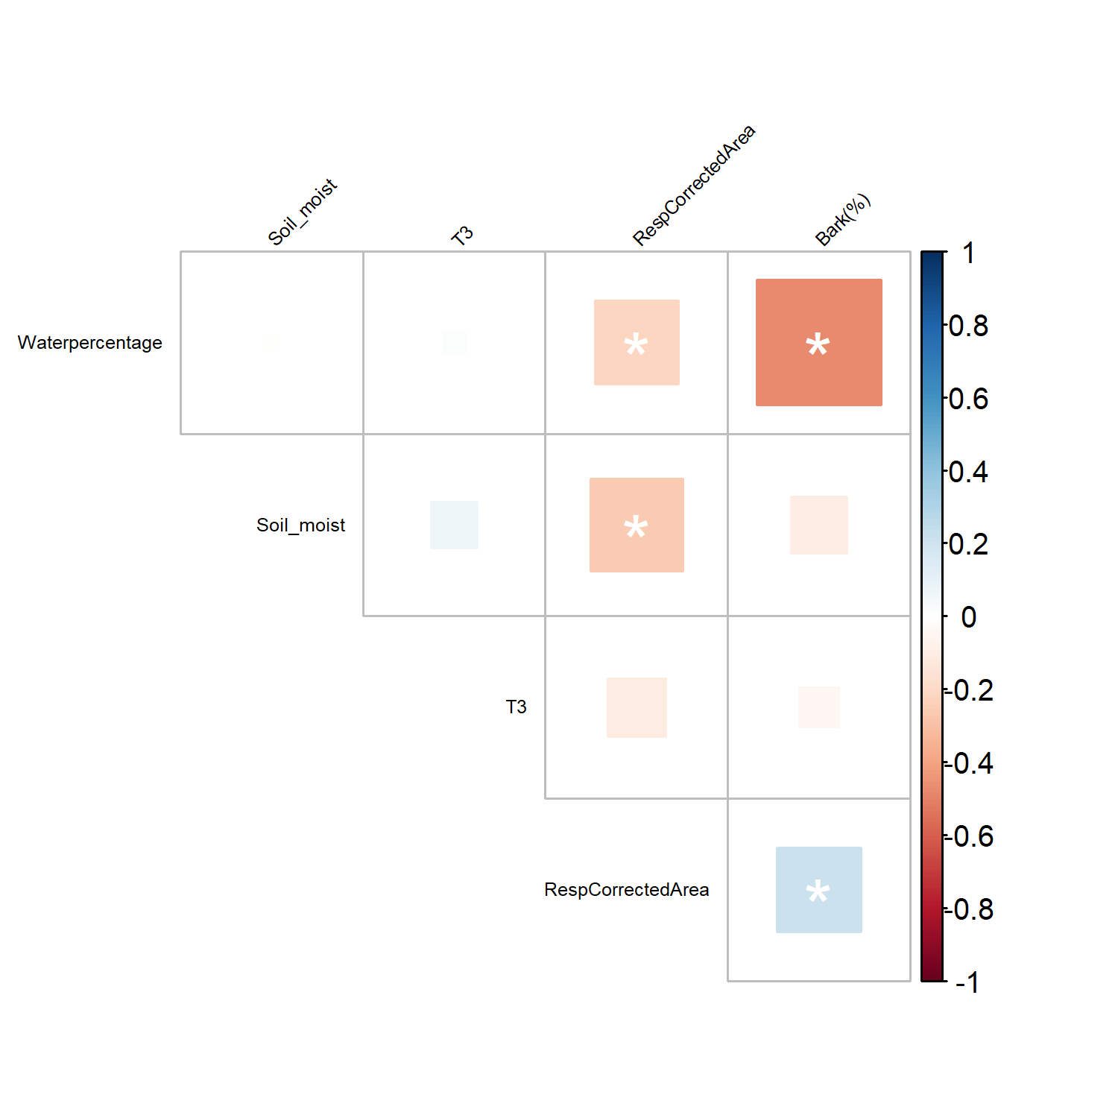
Fagus sylvatica
Pearson Correlation
1 cm
10 cm
25 cm
Pearson correlation of three diameter classes (1, 10 and 25 cm) of Fagus sylvatica. * denote statistically significant correlation at p < 0.05

Slide 18
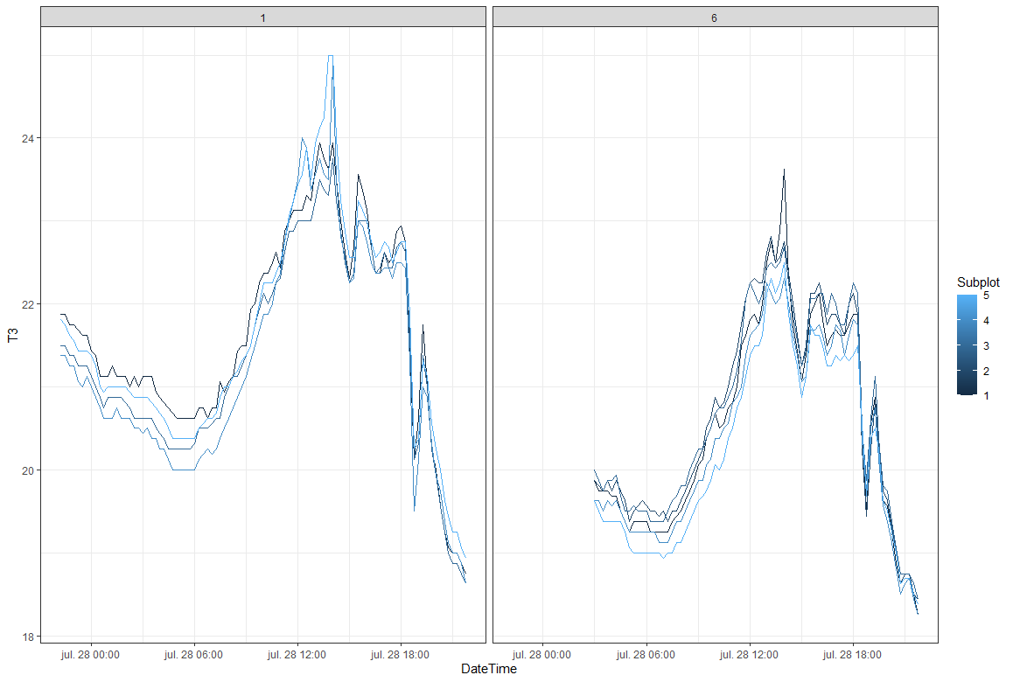
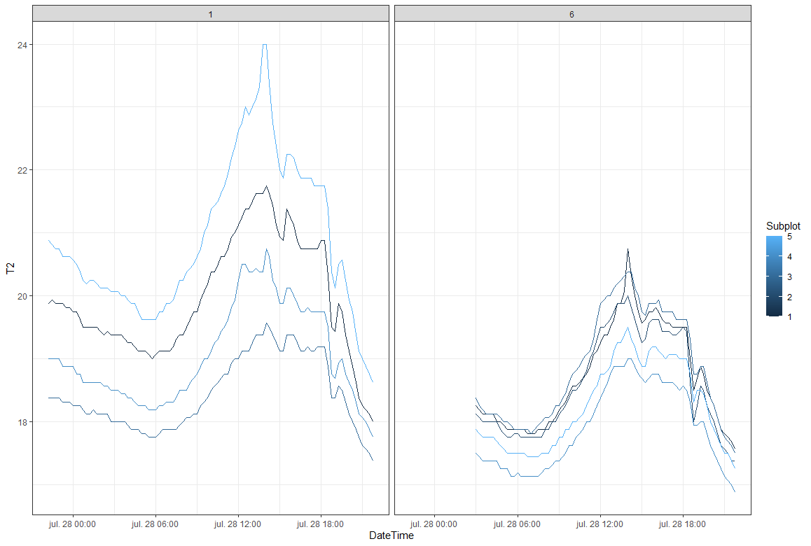
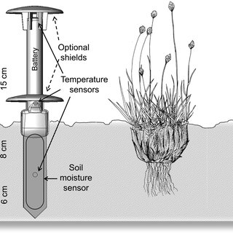
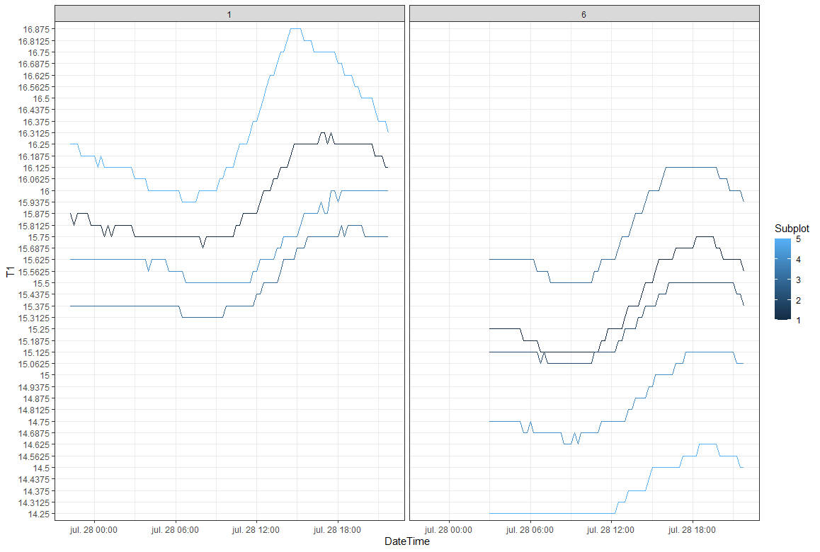
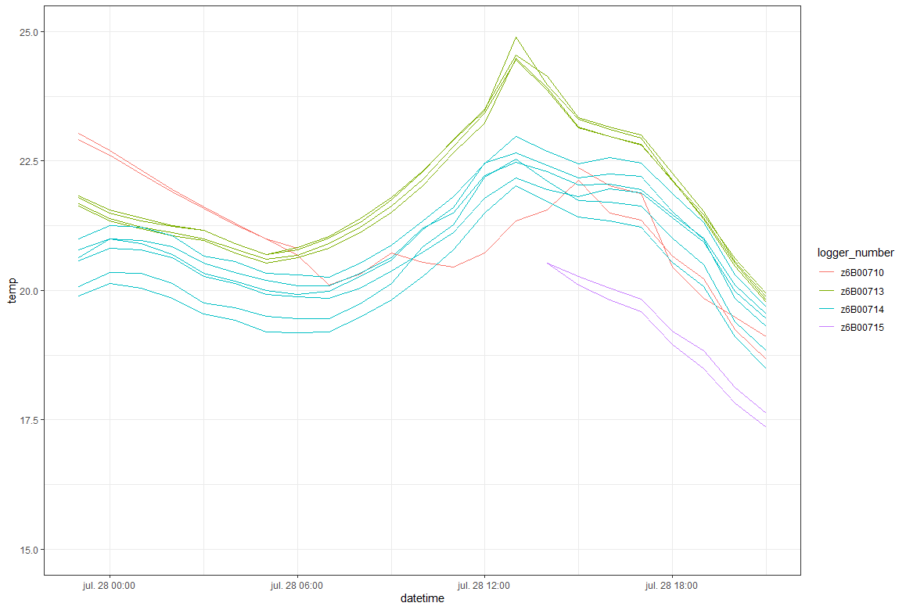
Temperature (ºc) measured at 15 cm in the air (A), soil level (B) and 6 cm into the ground (C) and 5 cm into the logs (D) at 28th of July of 2021. Each datalogger corresponds to a Plot.

Slide 19
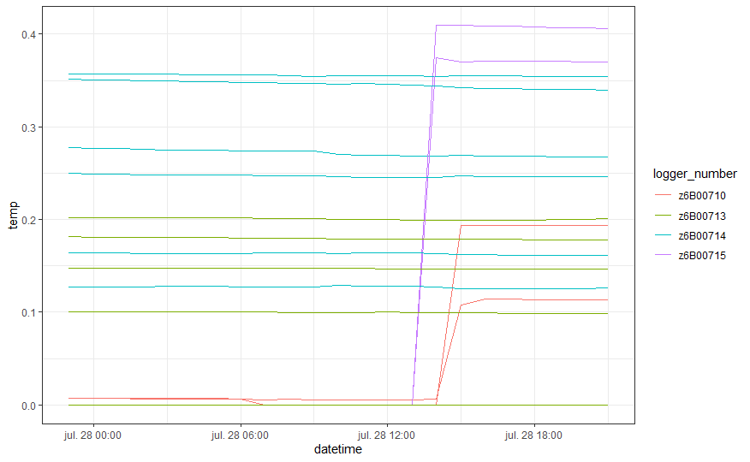
Water content (units?)
Soil moisture in (???) Measured by the Theros 11 sensors in the Wood at 28th of July 2021

Slide 20
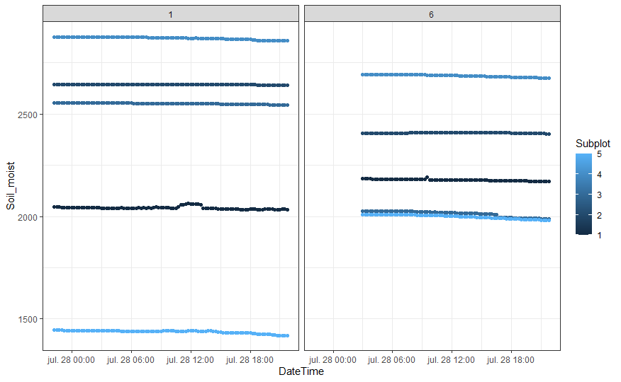
Units? g/kg?
Soil moisture in (???) 6 cm Deep into the soil of plots 1 and 6 during the 28th of July 2021

